Slide 1
User Interface Design WPF
Database Application Development
Lecturer: Garry singh
Manukau Institute of Technology

Slide 2
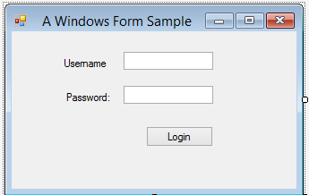
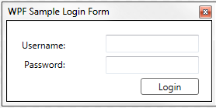
Windows User Interfaces
Visual Studio provides different types of user interfaces for desktop applications:
Console: The text only user interface.
Windows Forms: Traditional way of Windows GUI programming.
Windows Presentation Foundations (WPF): It provides a wider range of application types and attempts to solve a number of problems with Windows Forms.

Slide 3
Application Execution Flow 1. Windows Console Applications
When a Windows application with GUI executes, it functions differently from the console-based applications you have been writing:
With a console-based application, each line in the Main( ) method is executed sequentially. Then the program halts.
Method calls might branch to different locations in your program; however, control always returns back to the Main( ) method.

Slide 4
Application Execution Flow 1. Windows Console Applications
Program.cs
Main()
{
Commands that use console as interface
}
Console Application

Slide 5
Application Execution Flow 2. Windows GUI Applications Graphical User Interface (GUI)
The interface is the front end of a program. It is the visual image you see when you run a program.
The interface is what allows users to interact with your program.
Console is an interface, but it’s not graphical.
Windows forms are GUIs.
A graphical user interface (GUI) can include menus, buttons, pictures, and text in many different colors and sizes.

Slide 6
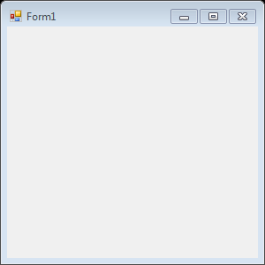
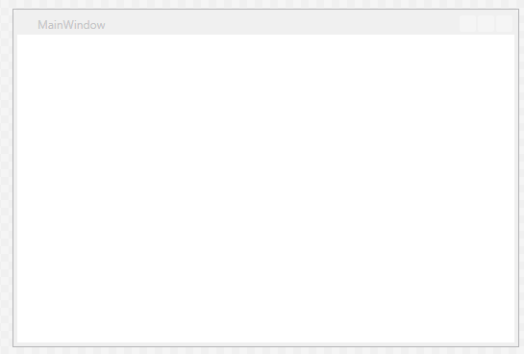
Application Execution Flow 2. Windows GUI Applications Graphical User Interface (GUI)
Think of these Form/Window as a container waiting to hold additional controls, such as buttons or labels.
Windows Form
WPF Window

Slide 7
Application Execution Flow 2. Windows GUI Applications Event-Driven
With a Windows GUI application, instead of the program executing sequential statements from top to bottom, the application, once launched, sits in what is called a process loop waiting for an event to execute.
An event is a notification from the operating system that an action, such as the user clicking the mouse or pressing a key, has occurred.
With GUI applications, you write methods called event handlers to indicate what should be done when an event such as a mouse click on a button or the press of a key occurs.
This is called event-driven development.

Slide 8
Application Execution Flow 2. Windows GUI Applications Event-Driven
Events are usually associated with user actions.
For example, when the user clicks a button, that button generates an event indicating what just happened to it.
Handling the event is the means by which the programmer can provide some functionality for that button.

Slide 9
Human-Computer Interaction
As you start developing Windows applications, your goal should be to develop applications that are:
Usable:
that permit users to spot items in the windows quickly,
and that enable users to interact with your program.
Easy to understand
Attractive
Human-Computer Interaction (HCI) concentrates on the design and implementation of interactive computing systems for human use.

Slide 10
Why WPF?
There are several reasons that WPF is superior to Windows Form. For example:
Nowadays we have computers with different sizes of display.
Windows Forms do not provide appropriate scalability to support all of them as they use absolute position.
On the other hand, WPF uses relative position similar to website that provides much better scalability.

Slide 11
Extensible Application Markup Language (XAML)
You can use VS Designer to design WFP interfaces by dragging and dropping controls from a Toolbox to your window, placing them where you want them to appear when you run the application.
However, the user interface is in fact written entirely in another language called Extensible Application Markup Language (XAML, pronounced zammel).
For the best results, you need to combine both in order to have advanced flexibility to design the interface.

Slide 12
XAML
XAML is a language that uses XML syntax and enables controls to be added to a user interface in a declarative, hierarchical way.
That is to say, you can add controls in the form of XML elements, and specify control properties with XML attributes.
You can also have controls that contain other controls, which is essential for both layout and functionality.

Slide 13
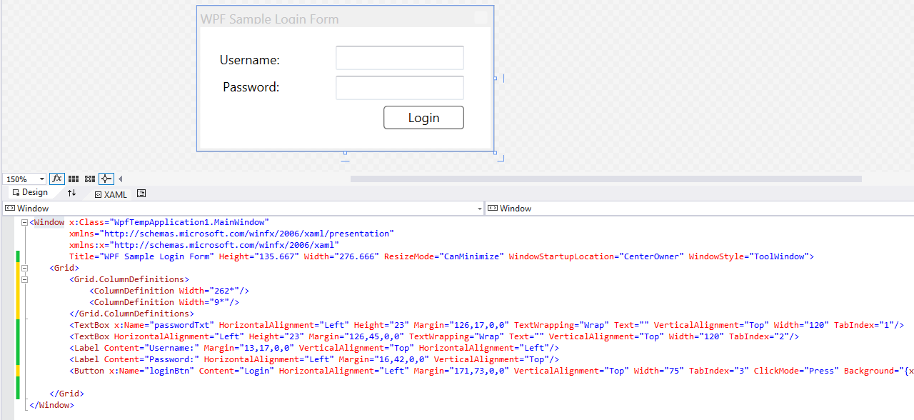
XAML

Slide 14
XAML Separation of Concern
One problem that exists with maintaining Windows applications that has been written over the years is that they very often mix the code that generates the user interface and the code that executes based on users actions.
WPF solves this in two ways.
First, by using XAML to describe the GUI rather than C#, the GUI becomes platform independent, and you can in fact render XAML without any code whatsoever.
Second, this means that it feels natural to place the C# code in a different file than you place the GUI code. Visual Studio utilizes something called code-behind files, which are C# files that are dynamically linked to the XAML files.

Slide 15
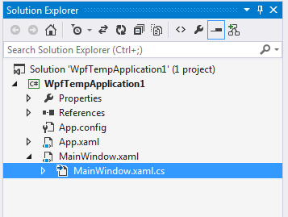
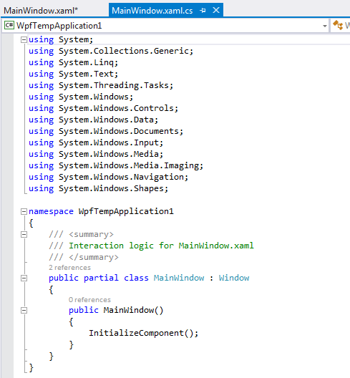
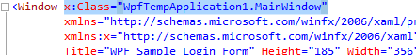
XAML Separation of Concern Code-behind Files
These files are normal C# files that have the same name as the XAML file, plus a .cs extension.
Visual Studio creates code-behind files automatically when you create a new window in your application, because it expects you to add code to the window.
It also adds the x:Class property to the Window tag in the XAML:

